Slide 1
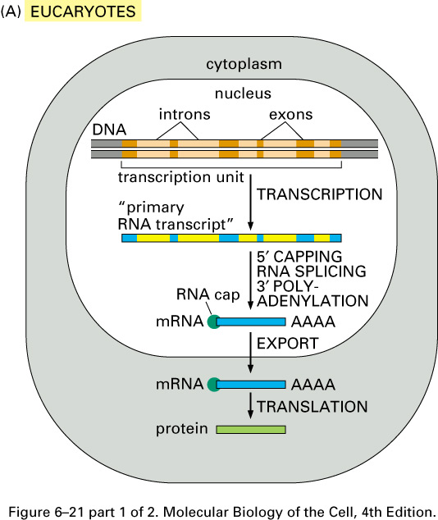
RNA PROCESSING
Summary of the steps leading from gene to protein in eucaryotes and bacteria. The final level of a protein in the cell depends on the efficiency of each step and on the rates of degradation of the RNA and protein molecules. (A) In eucaryotic cells the RNA molecule produced by transcription alone (sometimes referred to as the primary transcript) would contain both coding (exon) and noncoding (intron) sequences. Before it can be translated into protein, the two ends of the RNA are modified, the introns are removed by an enzymatically catalyzed RNA splicing reaction, and the resulting mRNA is transported from the nucleus to the cytoplasm. Although these steps are depicted as occurring one at a time, in a sequence, in reality they are coupled and different steps can occur simultaneously. For example, the RNA cap is added and splicing typically begins before transcription has been completed. Because of this coupling, complete primary RNA transcripts do not typically exist in the cell.

Slide 2
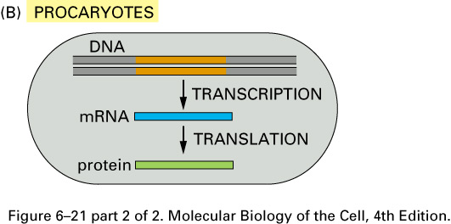
(B) In procaryotes the production of mRNA molecules is much simpler. The 5' end of an mRNA molecule is produced by the initiation of transcription by RNA polymerase, and the 3' end is produced by the termination of transcription. Since procaryotic cells lack a nucleus, transcription and translation take place in a common compartment. In fact, translation of a bacterial mRNA often begins before its synthesis has been completed.

Slide 3
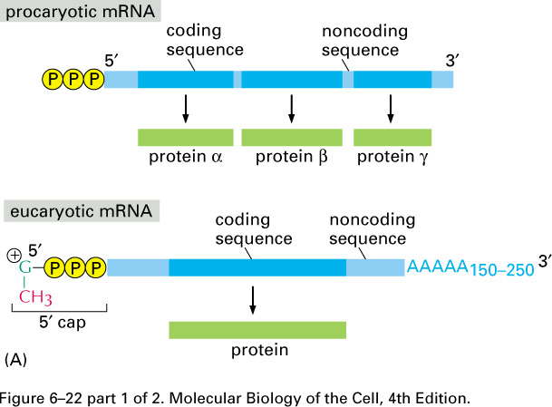
A comparison of the structures of procaryotic and eucaryotic mRNA molecules. (A) The 5' and 3' ends of a bacterial mRNA are the unmodified ends of the chain synthesized by the RNA polymerase, which initiates and terminates transcription at those points, respectively. The corresponding ends of a eucaryotic mRNA are formed by adding a 5' cap and by cleavage of the pre-mRNA transcript and the addition of a poly-A tail, respectively. The figure also illustrates another difference between the procaryotic and eucaryotic mRNAs: bacterial mRNAs can contain the instructions for several different proteins, whereas eucaryotic mRNAs nearly always contain the information for only a single protein.

Slide 4
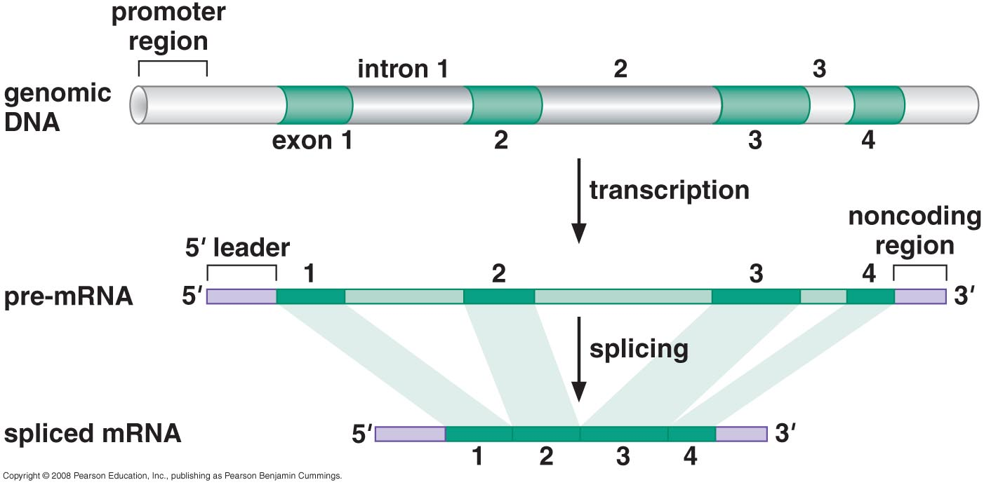
RNA Splicing

Slide 5
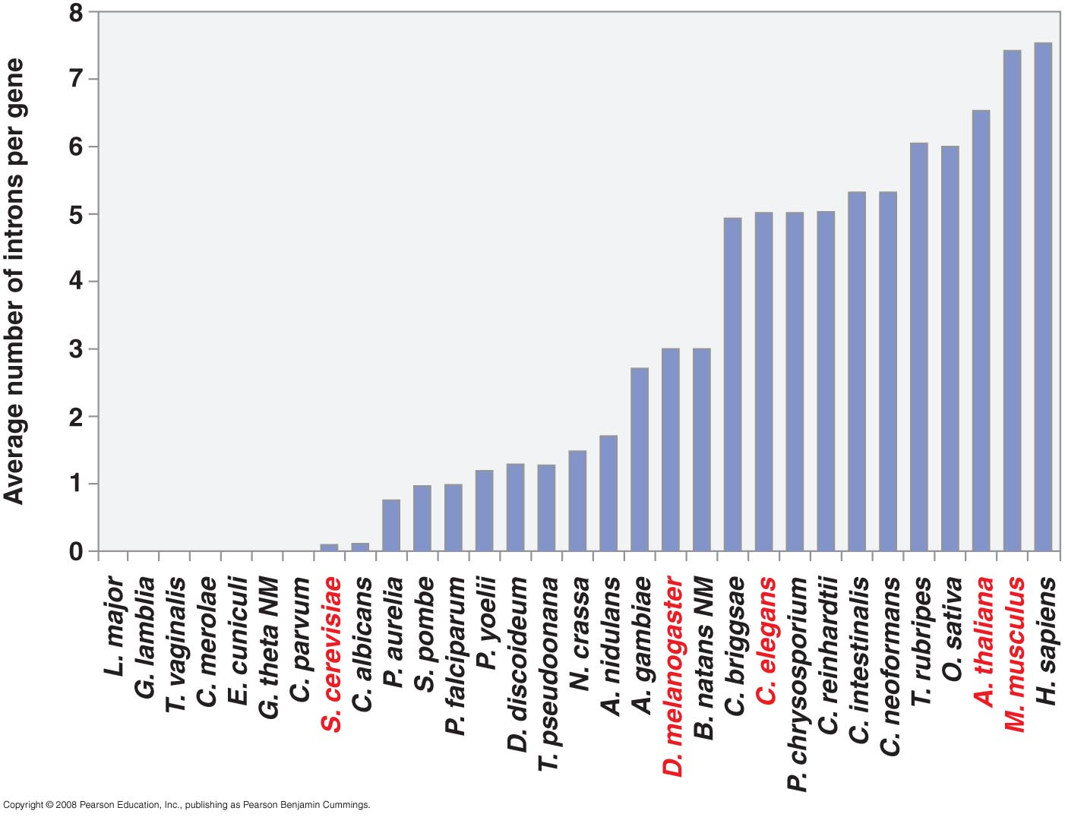
Number of introns per gene in various eukaryotic species

Slide 6
THE CHEMISTRY OF RNA SPLICING
Sequences within the RNA determine where splicing occurs

Slide 7
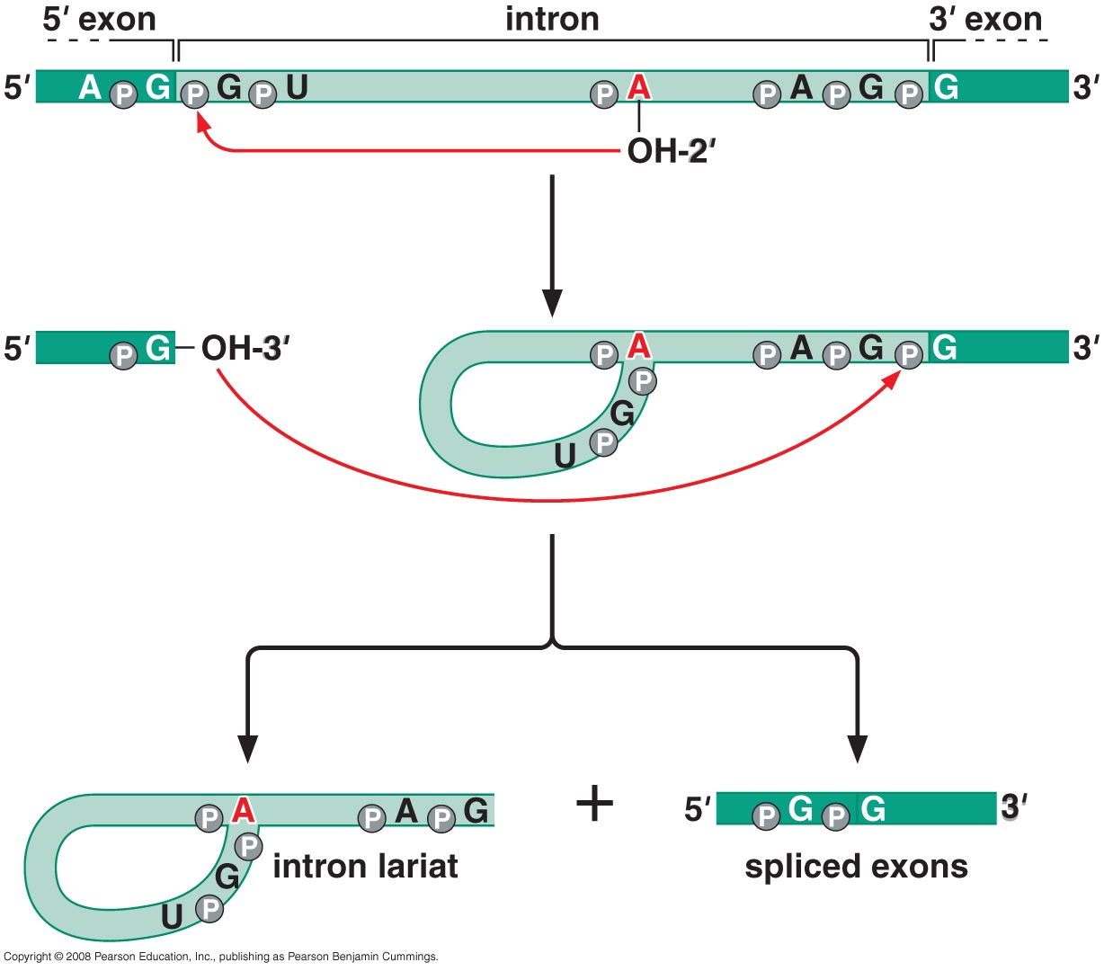
The intron is removed in a form called lariat and the flanking exons are joined

Slide 8
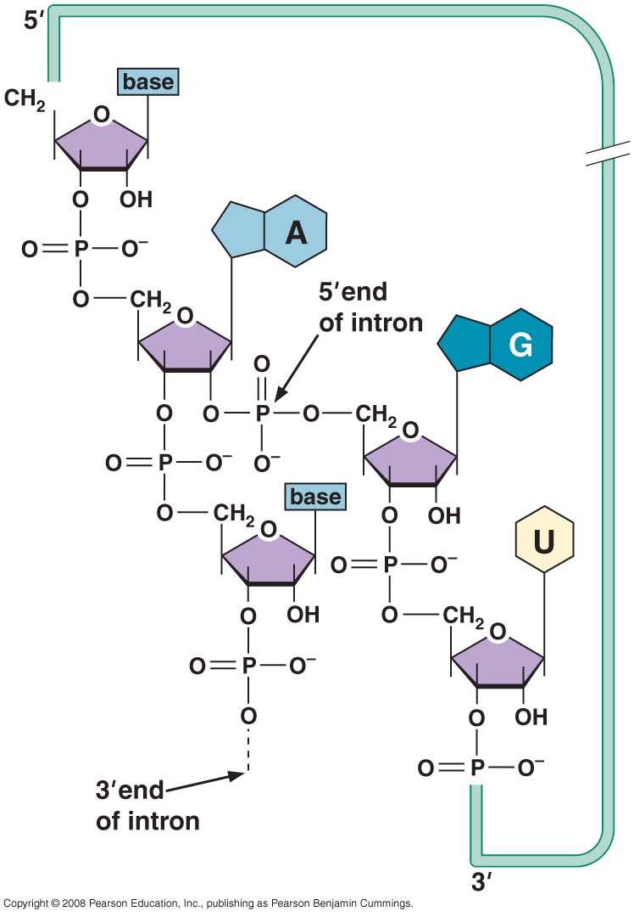
The structure of the three-way junction formed during the splicing reaction

Slide 9
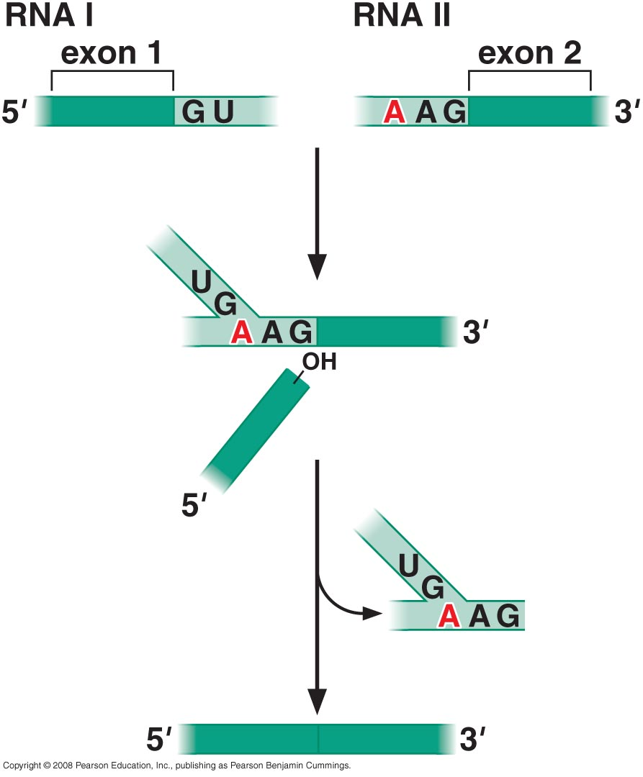
Exons from different RNA molecules can be fused by Trans-splicing

Slide 10
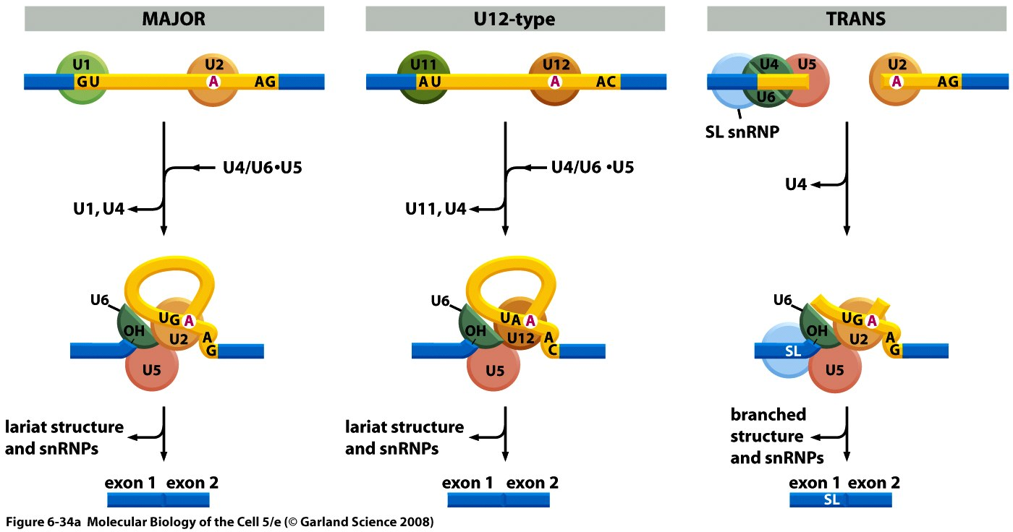
Outline of the mechanisms used for three types of RNA splicing.
(A) Three types of spliceosomes. The major spliceosome (left), the AT–AC spliceosome (middle), and the trans-spliceosome (right) are each shown at two stages of assembly. The U5 snRNP is the only component that is common to all three spliceosomes. Introns removed by the AT–AC spliceosome have a different set of consensus nucleotide sequences from those removed by the major spliceosome. In humans, it is estimated that 0.1% of introns are removed by the AT–AC spliceosome. In trans-splicing, the SL snRNP is consumed in the reaction because a portion of the SL snRNA becomes the first exon of the mature mRNA.

Slide 11
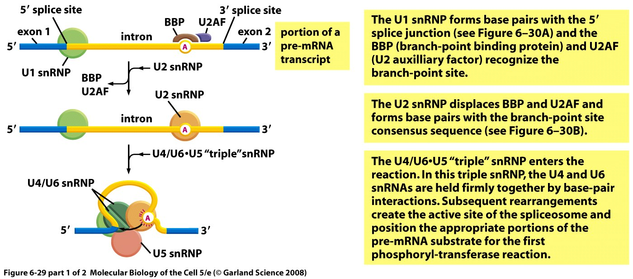
THE SPLICEOSOME MACHINERY
RNA splicing is carried out by a large complex called the spliceosome
snRNP (small nuclear ribonuclear proteins)

Slide 12
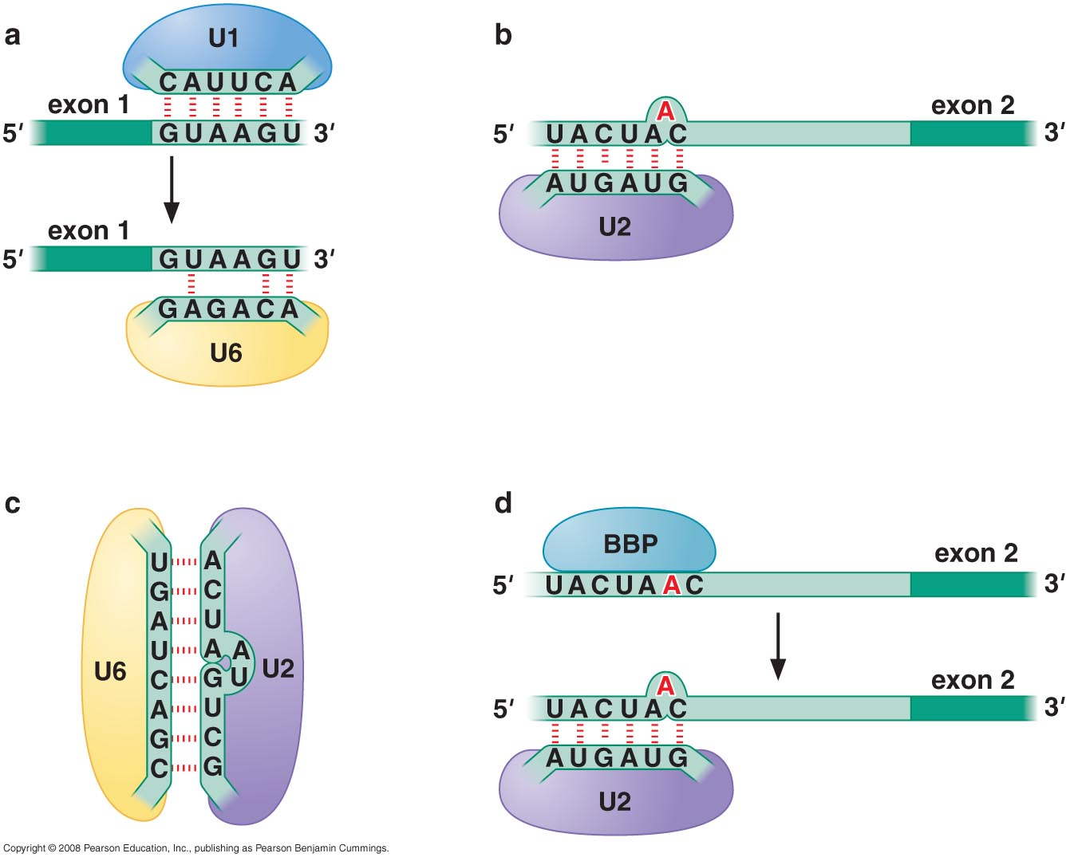
Some RNA-RNA hybrids formed during the splicing reaction

Slide 13
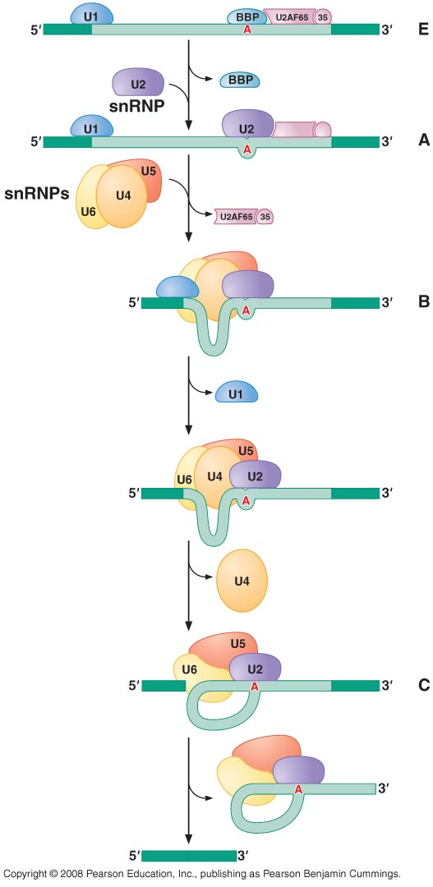
Assembly, rearrangements, and catalysis within the spliceosome
Steps of spliceosome-mediated splicing reaction

Slide 14
Several of the rearrangements that take place in the spliceosome during pre-mRNA splicing. Shown here are the details for the yeast Saccharomyces cerevisiae, in which the nucleotide sequences involved are slightly different from those in human cells. (A) The exchange of U1 snRNP for U6 snRNP occurs before the first phosphoryl-transfer reaction (see Figure 6–29). This exchange allows the 5' splice site to be read by two different snRNPs, thereby increasing the accuracy of 5' splice site selection by the spliceosome. (B) The branch-point site is first recognized by BBP and subsequently by U2 snRNP; as in (A), this “check and recheck” strategy provides increased accuracy of site selection. The binding of U2 to the branch-point forces the appropriate adenine (in red) to be unpaired and thereby activates it for the attack on the 5' splice site (see Figure 6–29). This, in combination with recognition by BBP, is the way in which the spliceosome accurately chooses the adenine that is ultimately to form the branch point.

Slide 15
The spliceosome uses ATP hydrolysis to produce a complex series of RNA-RNA rearrangements
. (C) After the first phosphoryl-transfer reaction (left) has occurred, U5 snRNP undergoes a rearrangement that brings the two exons into close proximity for the second phosphoryl-transfer reaction (right). The snRNAs both position the reactants and provide (either all or in part) the catalytic site for the two reactions. The U5 snRNP is present in the spliceosome before this rearrangement occurs; for clarity it has been omitted from the left panel. As discussed in the text, all of the RNA–RNA rearrangements shown in this figure (as well as others that occur in the spliceosome but are not shown) require the participation of additional proteins and ATP hydrolysis.

Slide 16
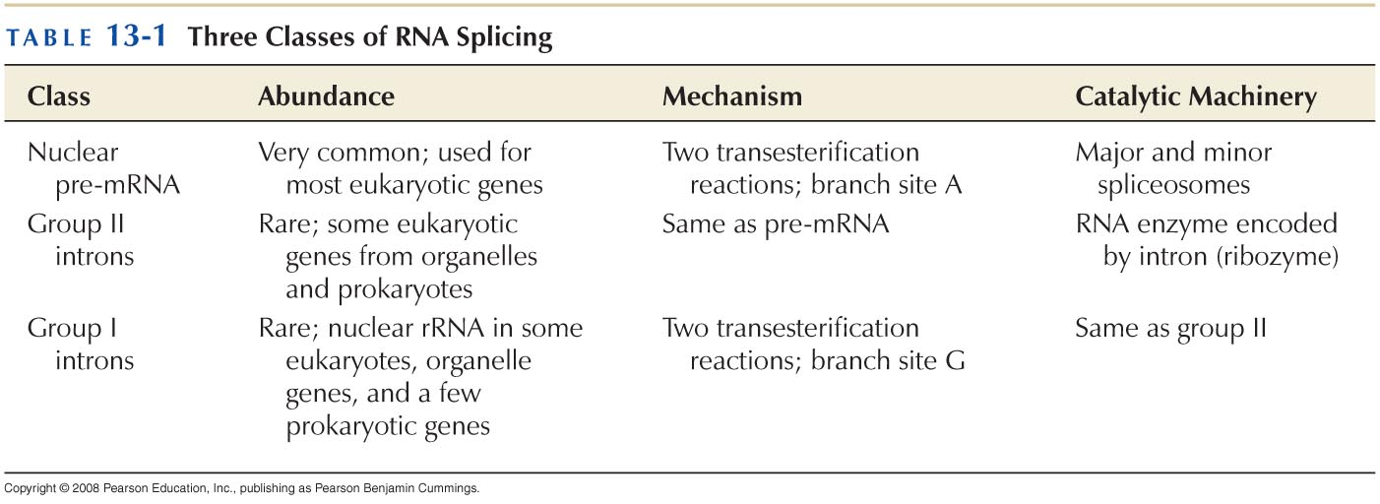
Self-splicing introns reveal that RNA can catalyze RNA splicing

Slide 17
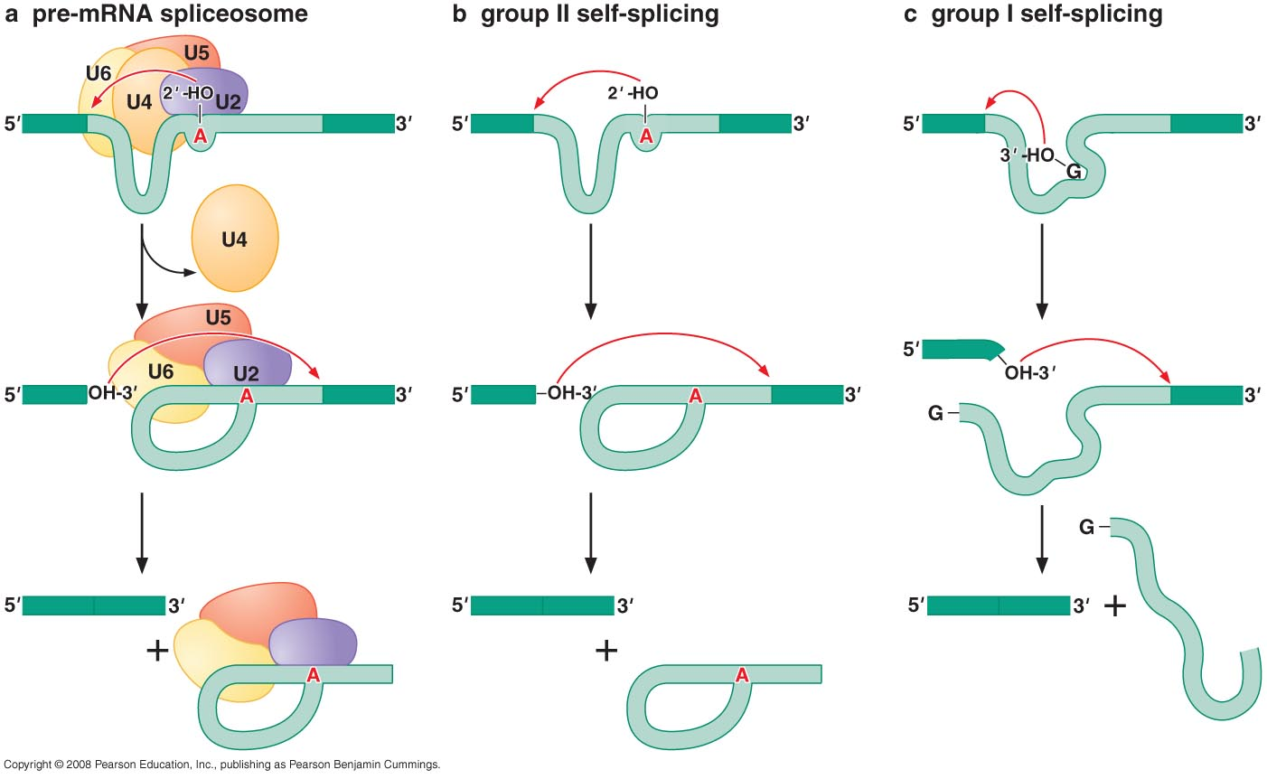
Group I introns release a linear intron rather than a lariat

Slide 18
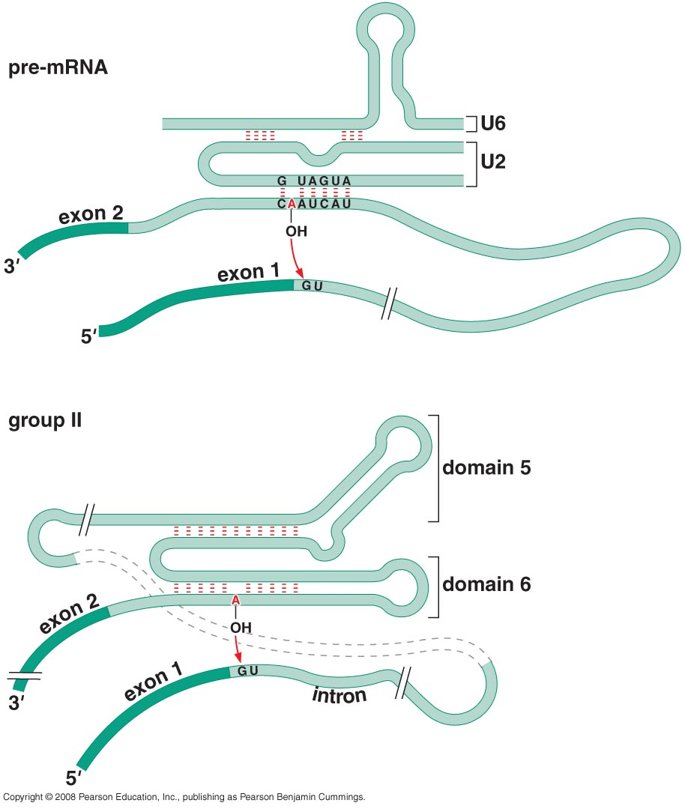
Proposed folding of the RNA catalytic regions for splicing of group II intron and pre-mRNA

Slide 19
The Nobel Prize in Chemistry 1989
"for their discovery of catalytic properties of RNA"
Sidney Altman | Thomas R. Cech
1/2 of the prize | 1/2 of the prize
Canada and USA | USA
Yale University New Haven, CT, USA | University of Colorado Boulder, CO, USA
b. 1939 | b. 1947

Slide 20
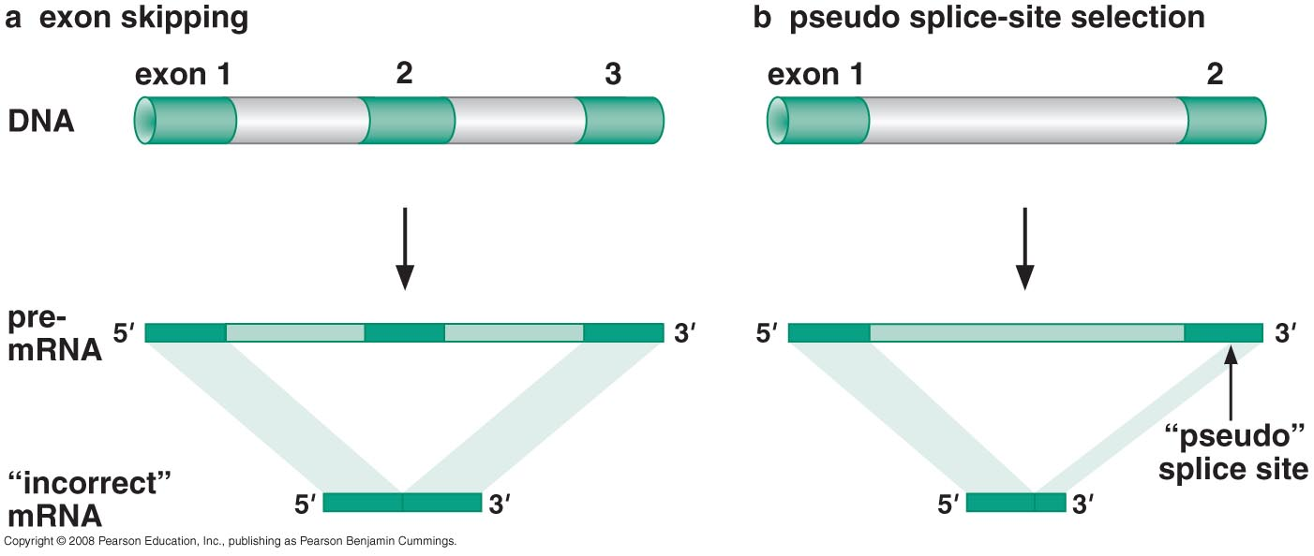
How does the spliceosome find the splice sites reliably
Errors produced by mistakes in splice-site selection

Slide 21
SR proteins recruit spliceosome components to the 5’ end and 3’ splice sites

Slide 22
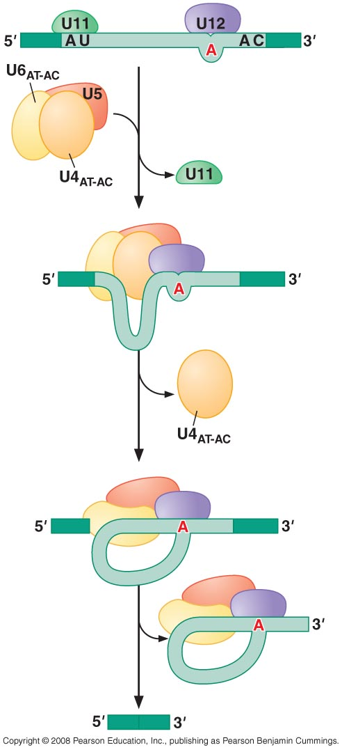
A small group of introns are spliced by an alternative spliceosome composed of a different set of snRNps

Slide 23
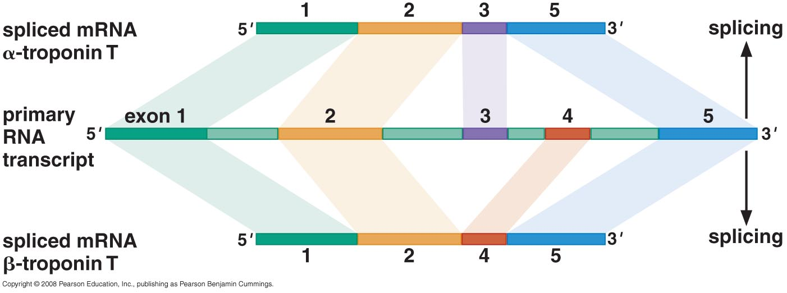
ALTERNATIVE SPLICING
Single gene can produce multiple products by alternative splicing

Slide 24
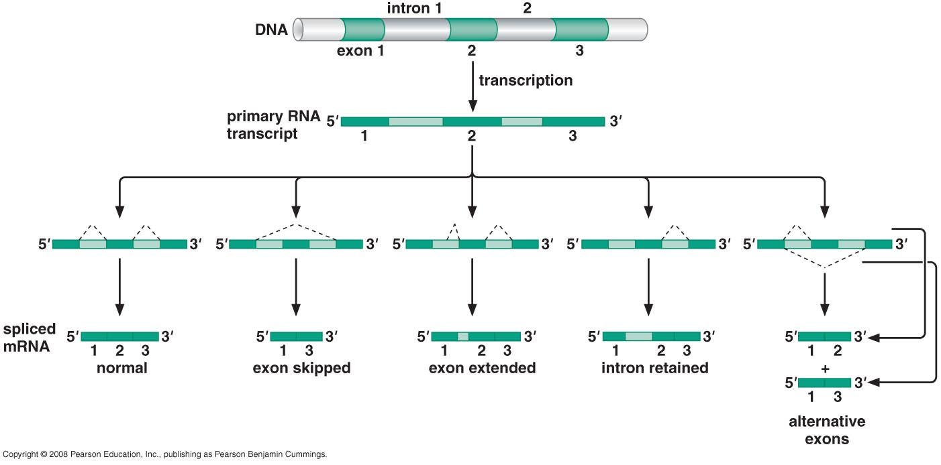
Five ways to splice an RNA

Slide 25
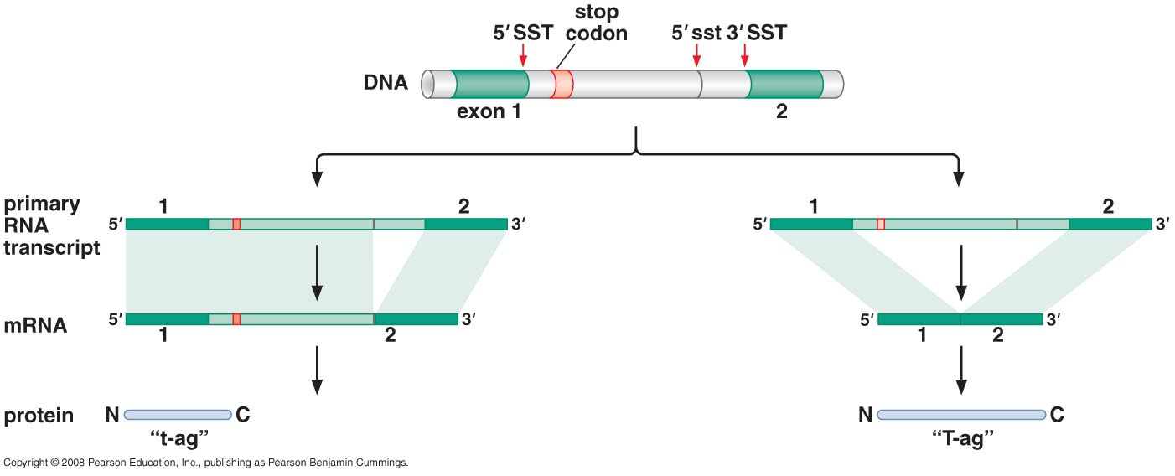
Alternative splicing of SV40 T-antigen

Slide 26
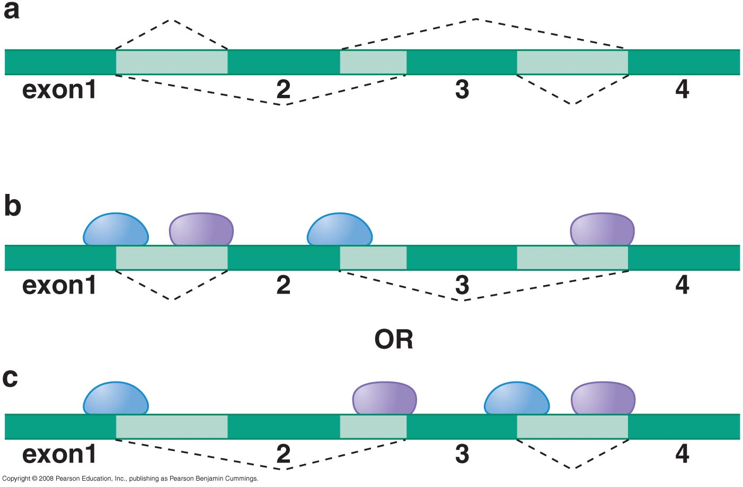
Several mechanisms exist to ensure mutually exclusive splicing
Steric hindrance

Slide 27
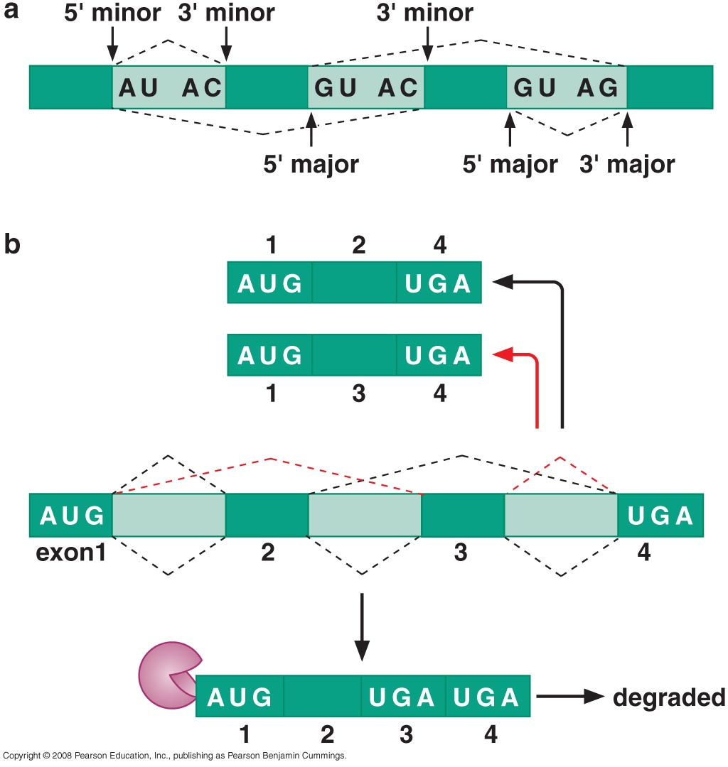
Combination of major and minor splice sites

Slide 28
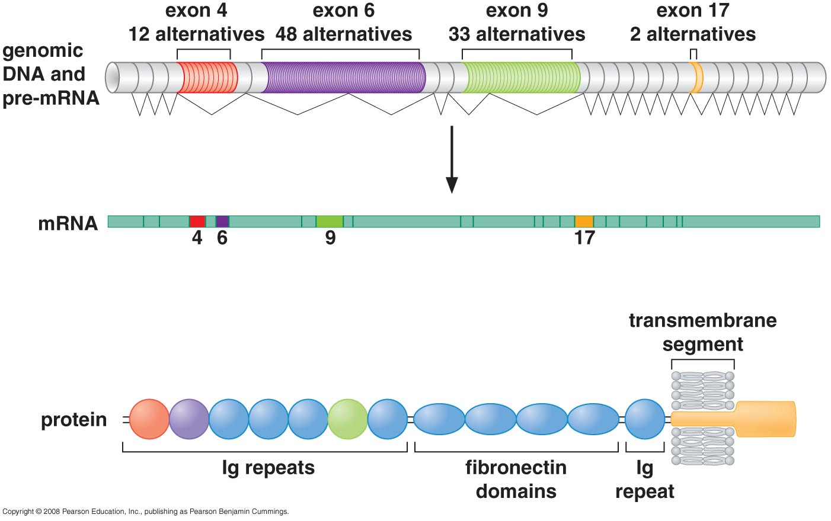
Mutually exclusive splicing on a grand scale
The multiple exons of the Drosophila Dscam gene

Slide 29
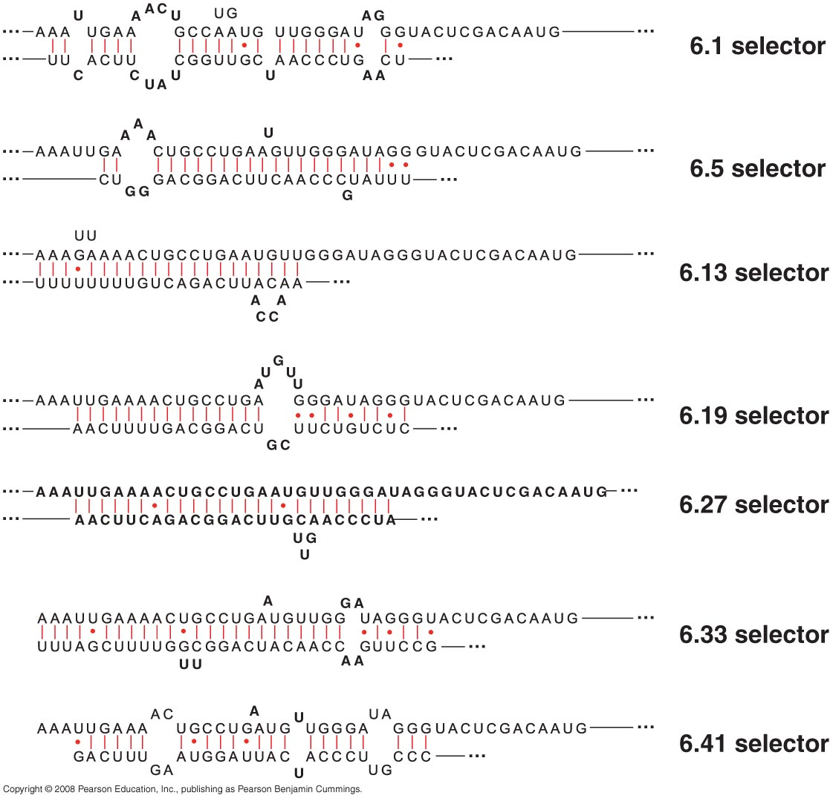
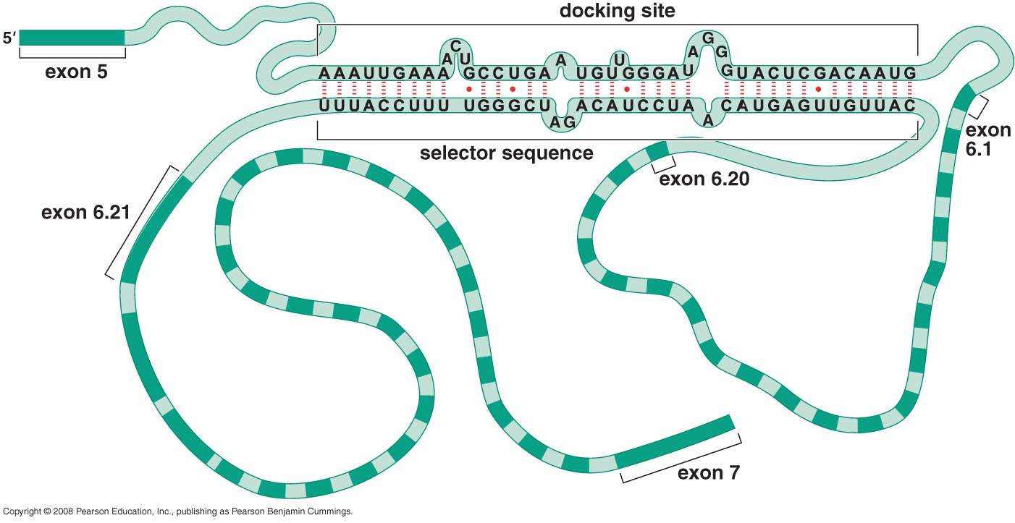
Splicing of Dscam Exon 6 uses a novel strategy

Slide 30
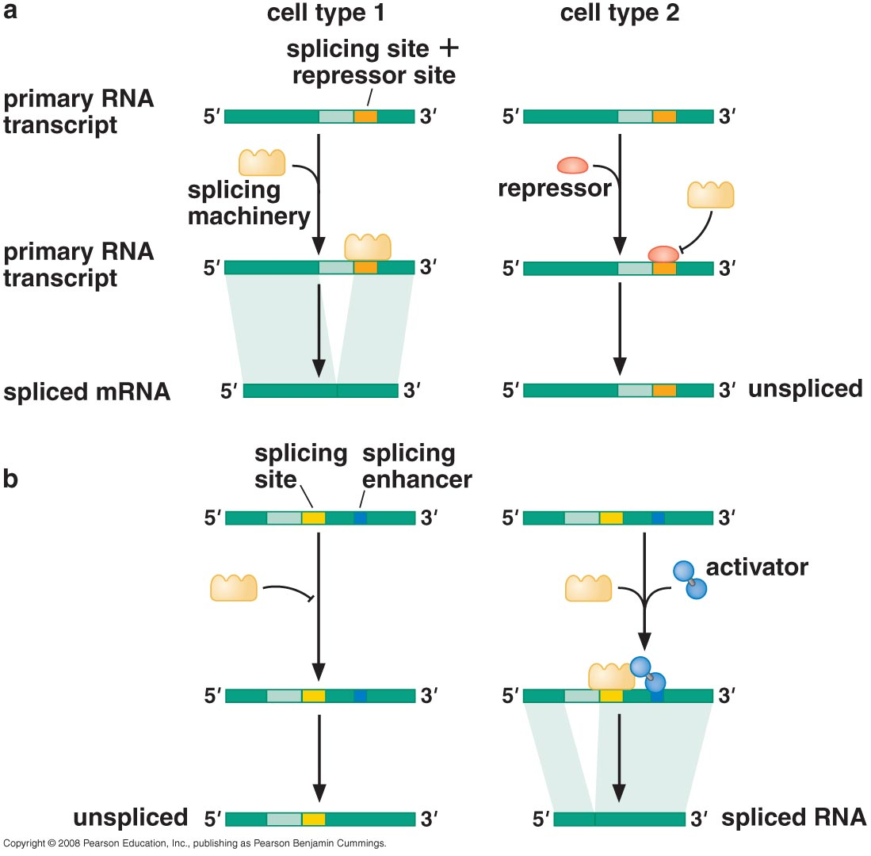
Alternative splicing is regulated by activators and repressors

Slide 31
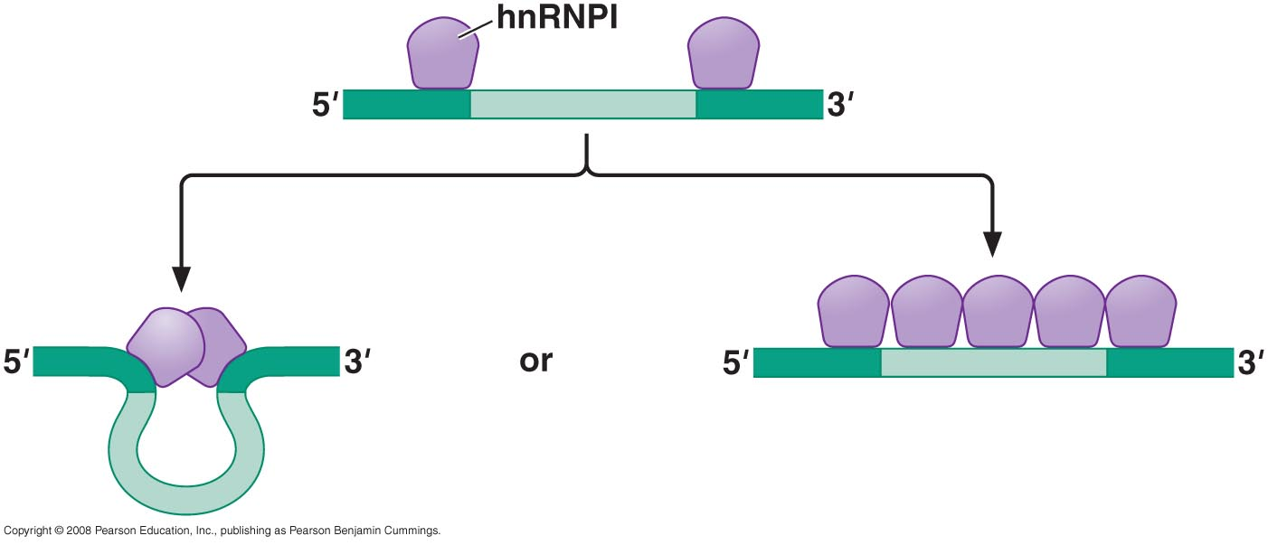
Inhibition of splicing by hnRNPI

Slide 32
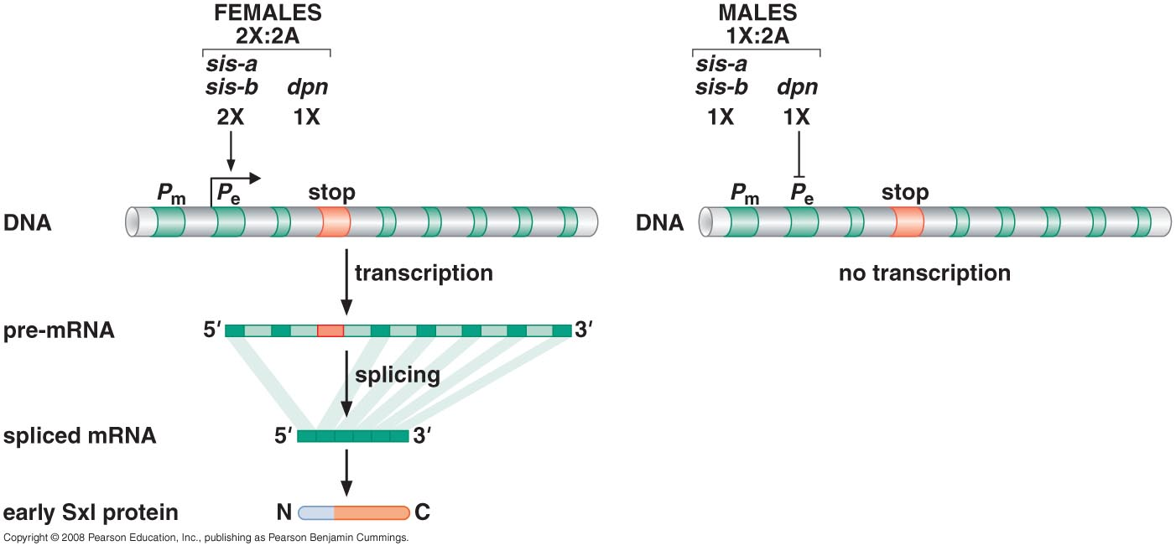
Regulation of alternative splicing determines the sex of flies
Early transcriptional regulation of SxI protein

Slide 33
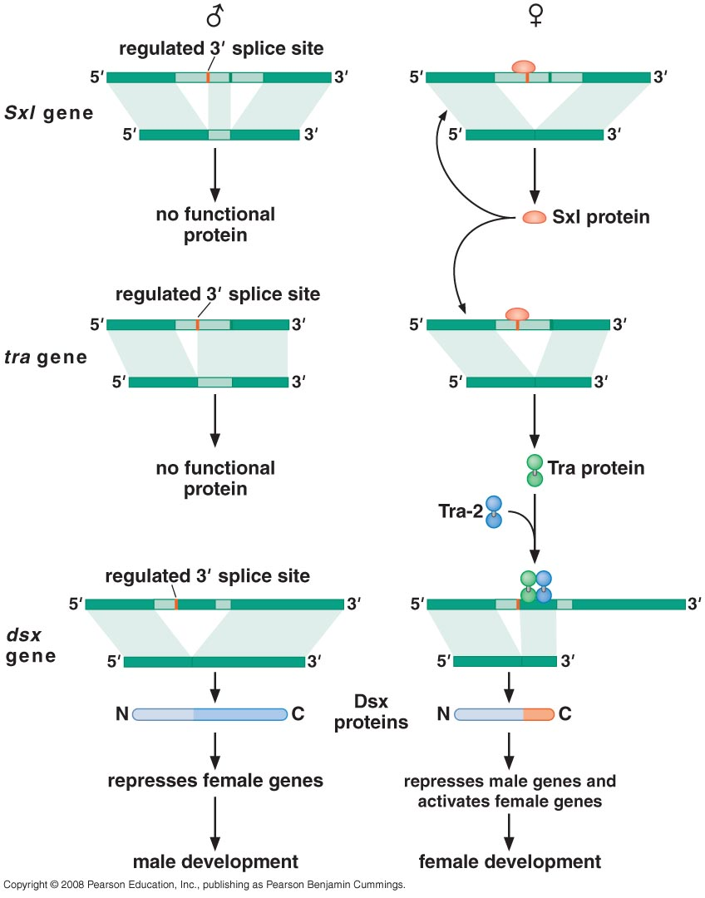
A cascade of alternative splicing events determines the sex of a fly

Slide 34
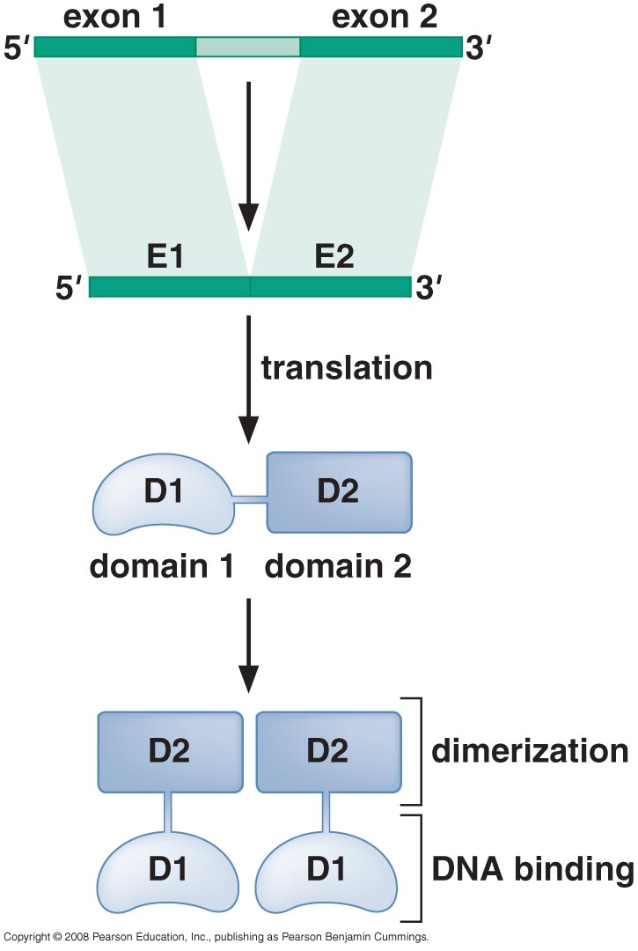
EXON SHUFFLING
Exons are shuffled by recombination to produce genes encoding new proteins

Slide 35
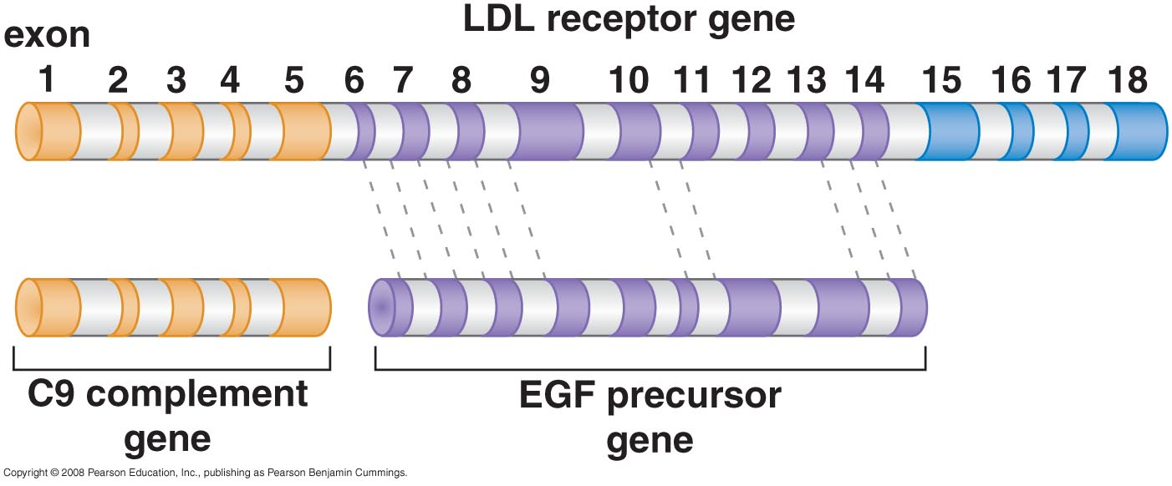
Genes made up parts of other genes

Slide 36
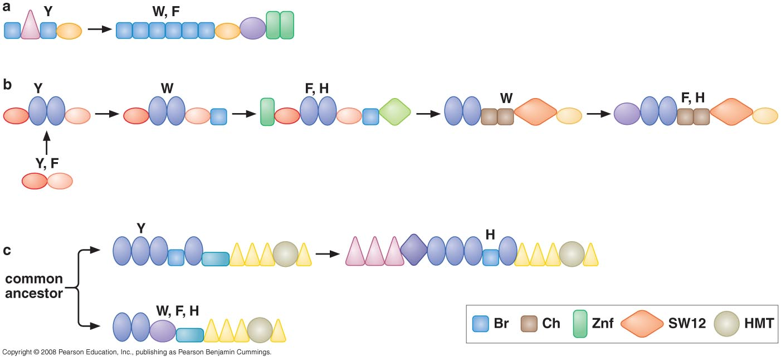
Proposed routs whereby different related proteins might have evolved by gain and loss of specific domains

Slide 37
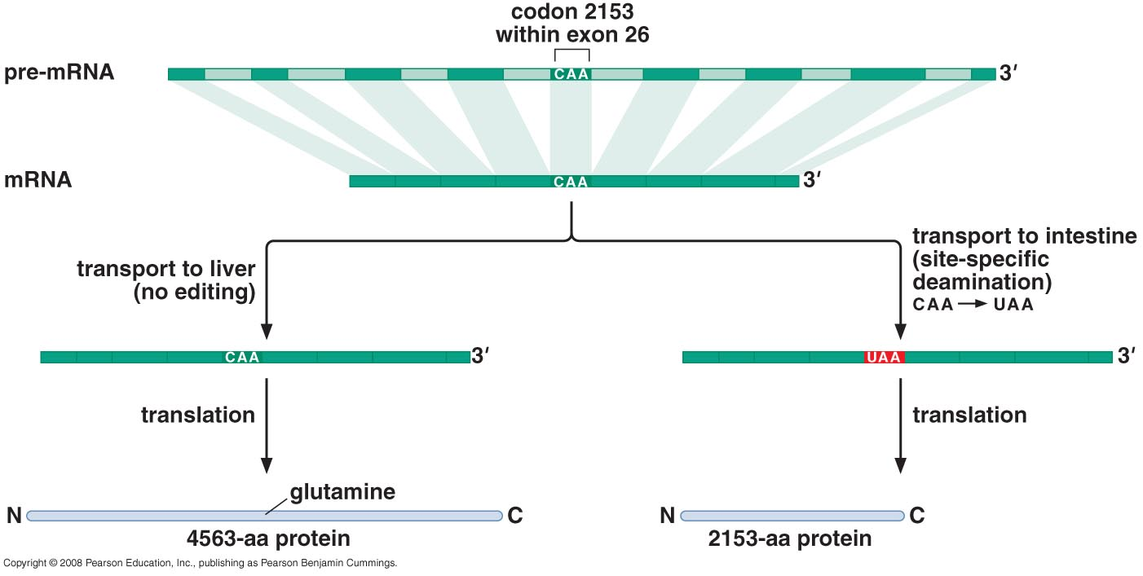
RNA EDITING
RNA editing is another way of altering the sequence of an mRNA

Slide 38
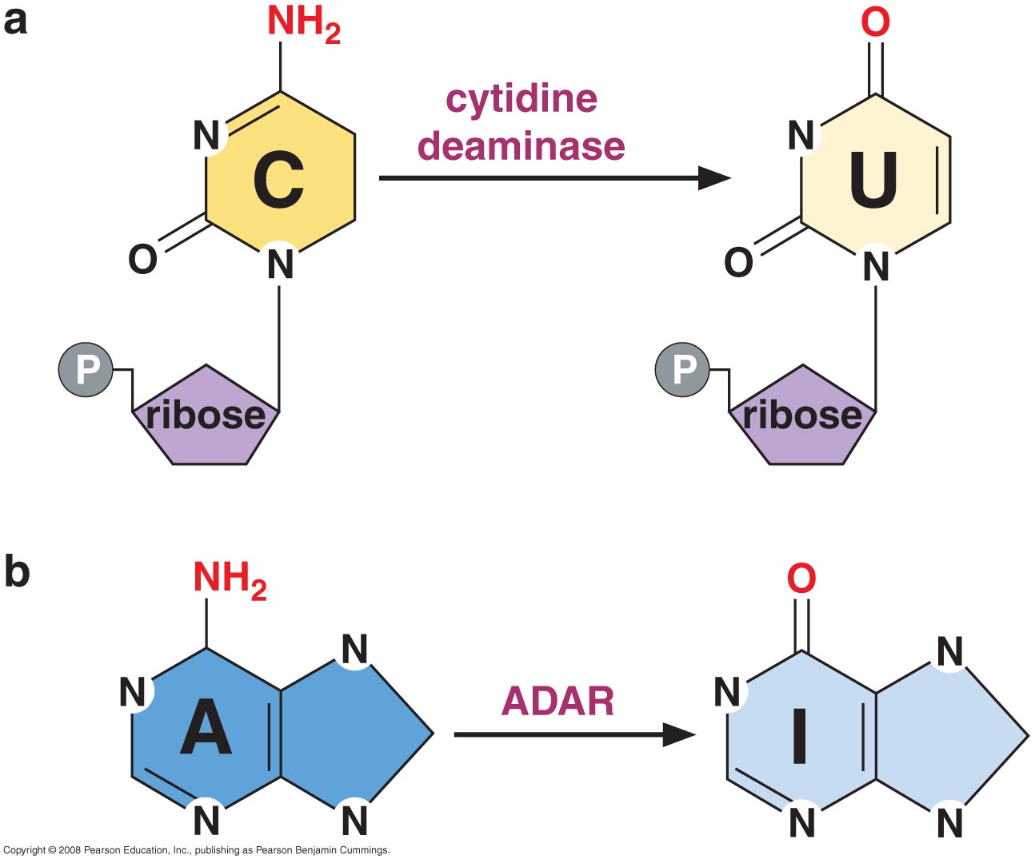
The deamination of C and A to produce U and Inosine

Slide 39
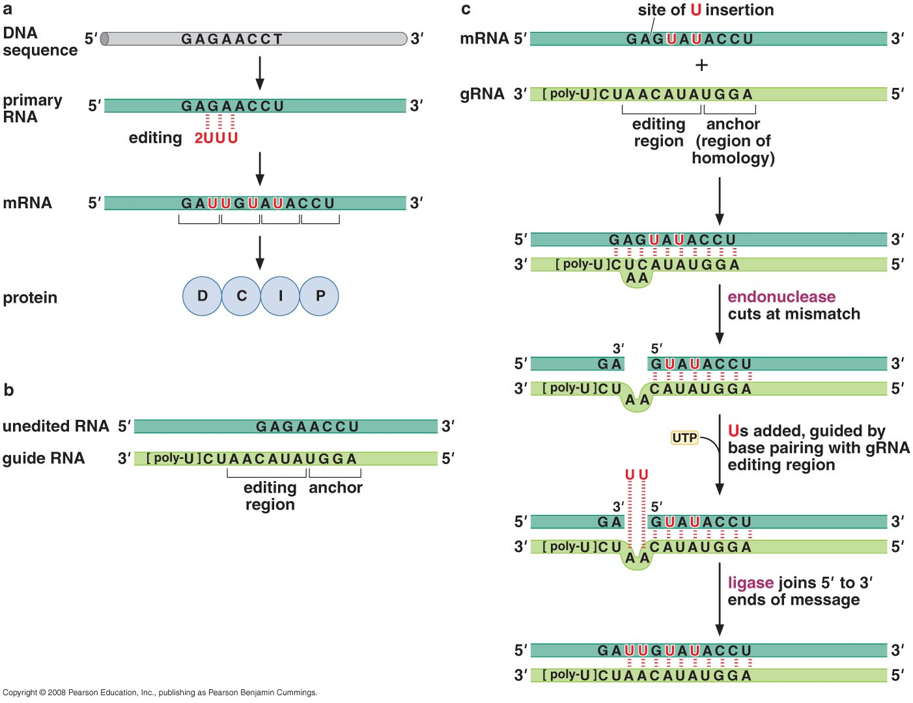
Guide RNA direct insertion and deletion of Uridines found in the mitochondria of Trypanosomes

Slide 40
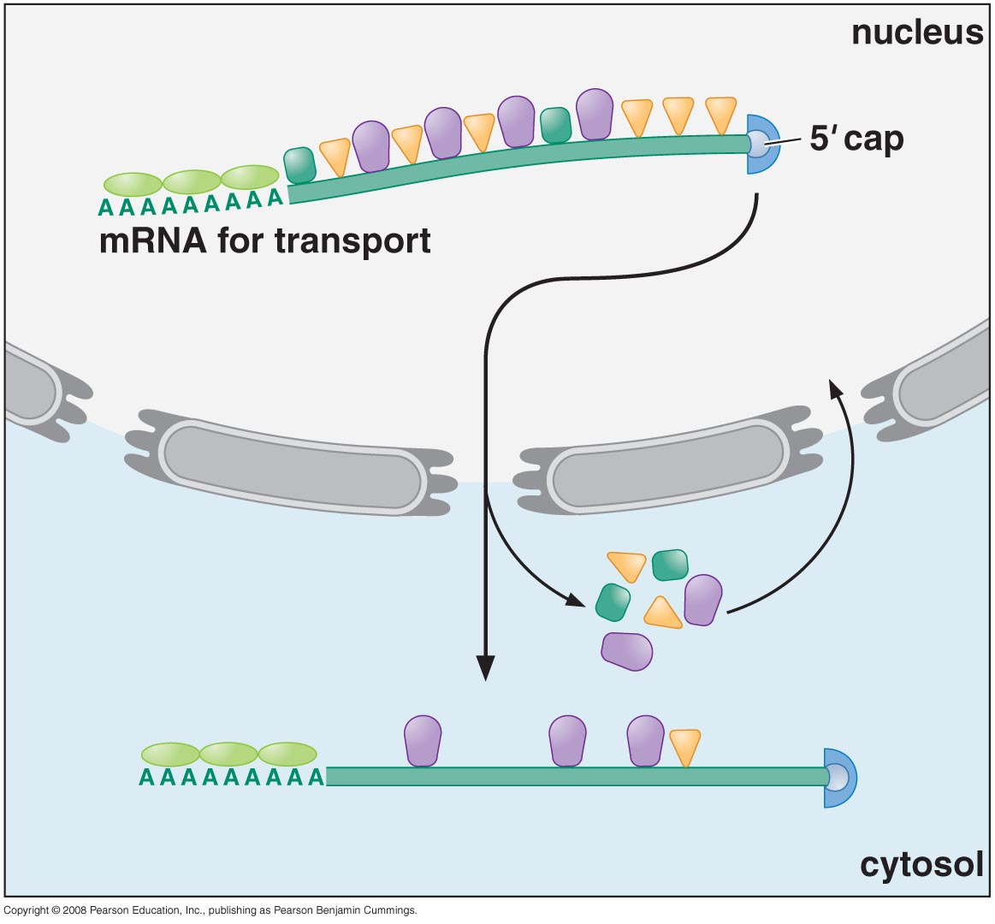
Once processed, mRNA is packaged and exported from the nucleus into the cytoplasma for translation

Slide 41
Schematic illustration of an “export- ready” mRNA molecule and its transport through the nuclear pore. As indicated, some proteins travel with the mRNA as it moves through the pore, whereas others remain in the nucleus. Once in the cytoplasm, the mRNA continues to shed previously bound proteins and acquire new ones; these substitutions affect the subsequent translation of the message. Because some are transported with the RNA, the proteins that become bound to an mRNA in the nucleus can influence its subsequent stability and translation in the cytosol. RNA export factors, shown in the nucleus, play an active role in transporting the mRNA to the cytosol (see Figure 12–16). Some are deposited at exon-exon boundaries as splicing is completed, thus signifying those regions of the RNA that have been properly spliced.

